Slide 1
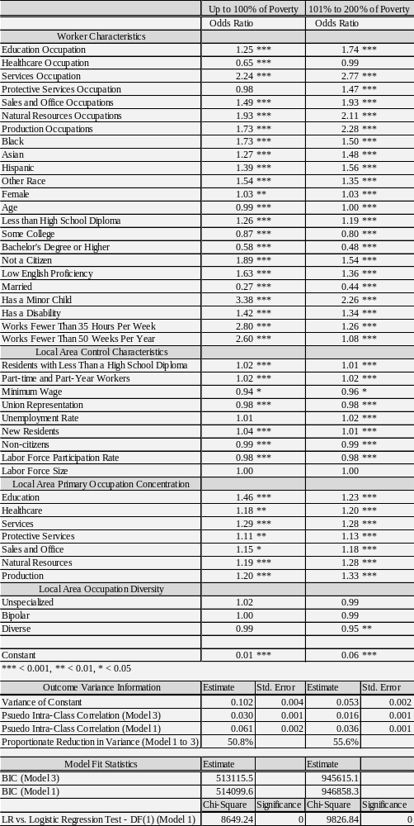
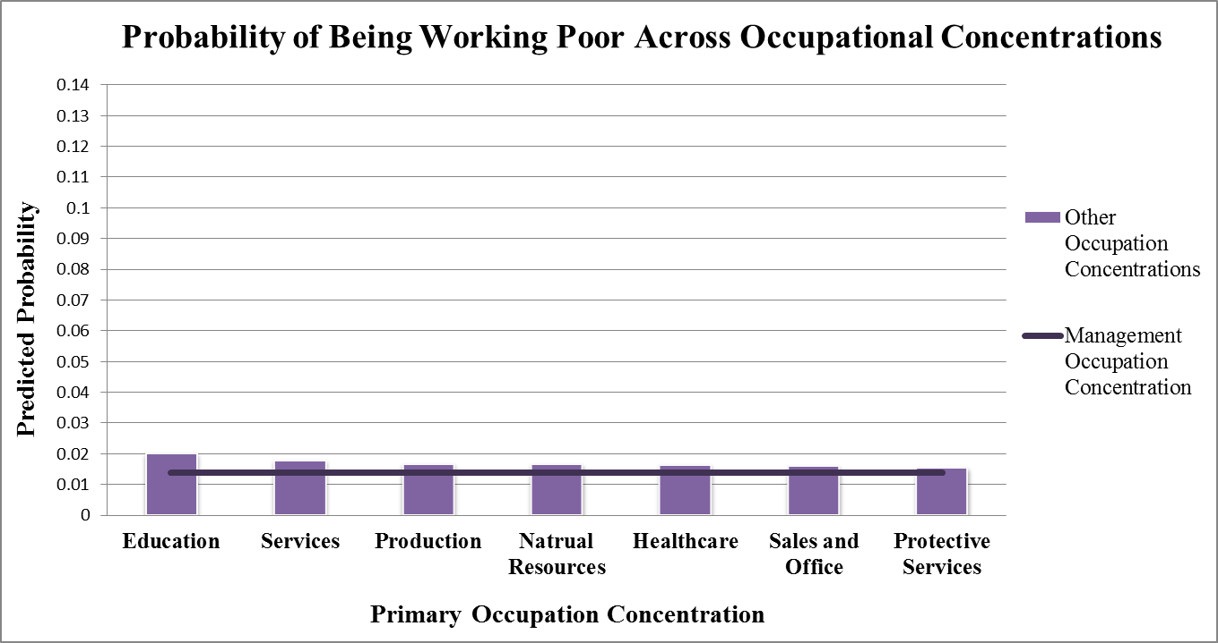
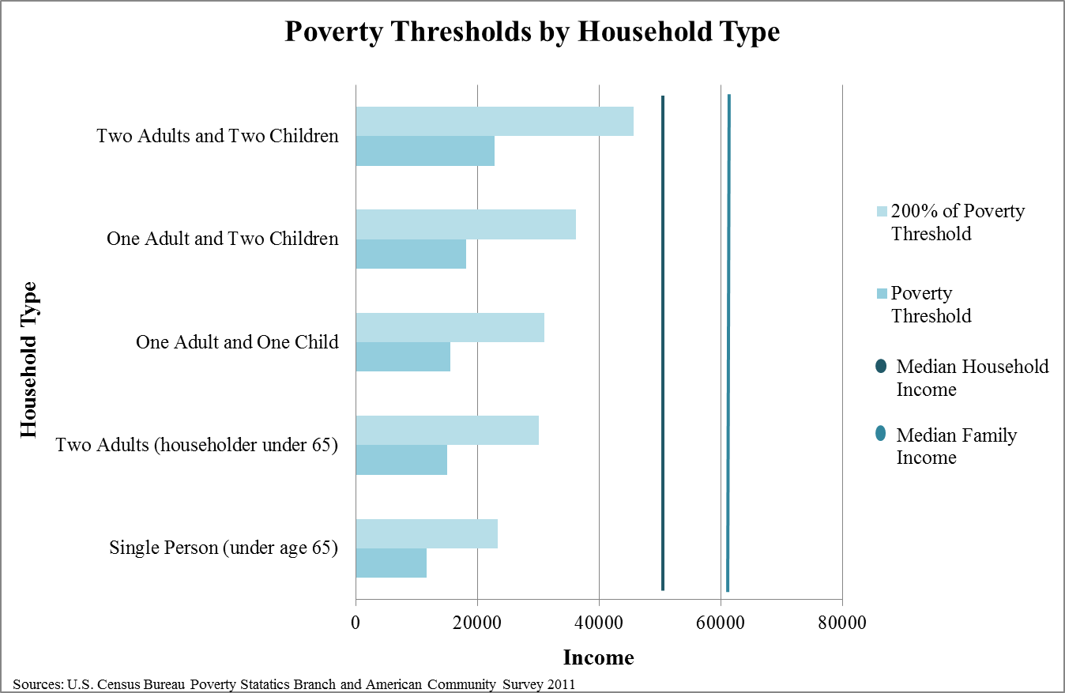
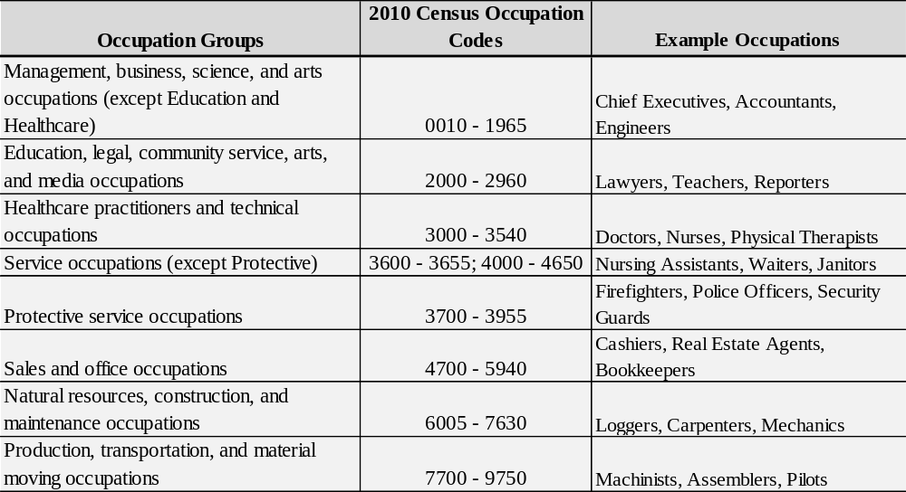
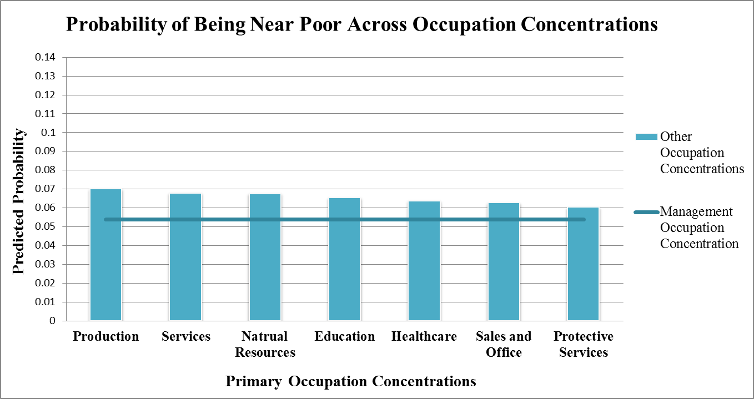
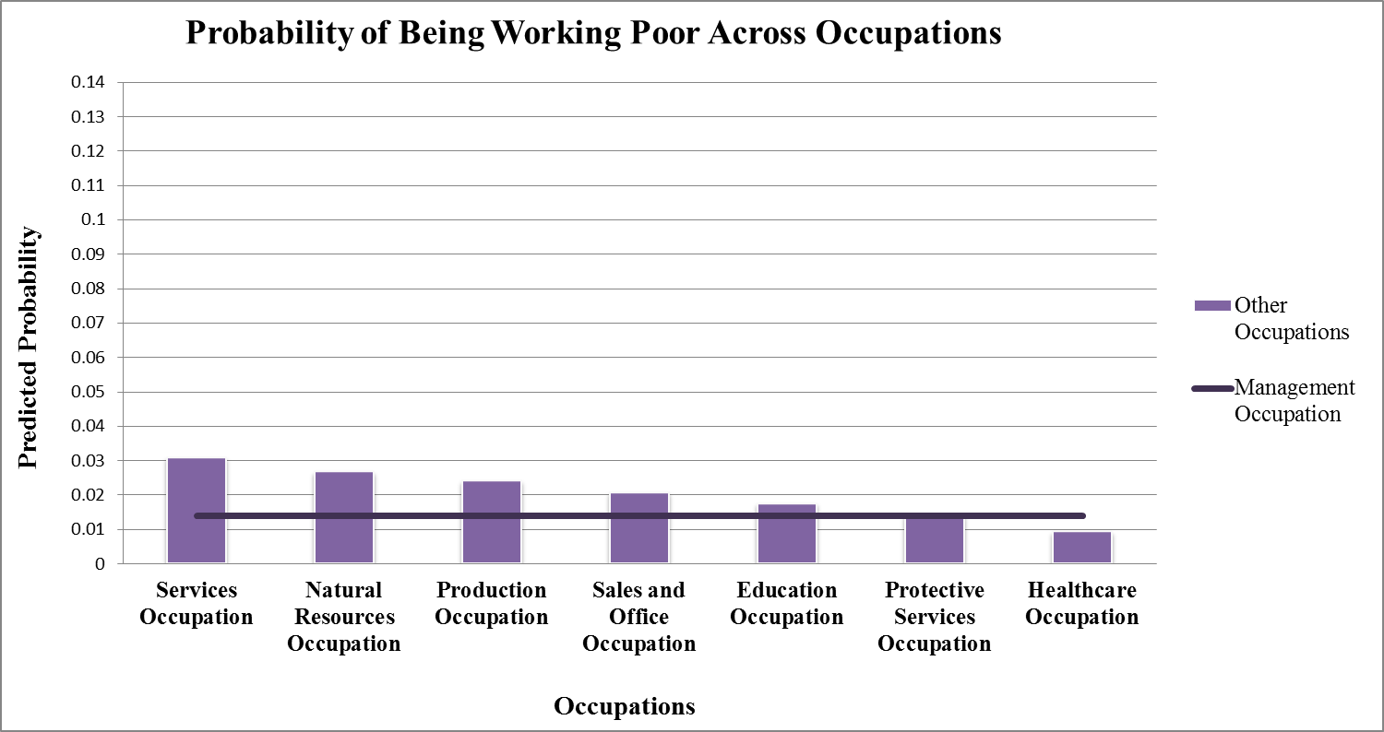
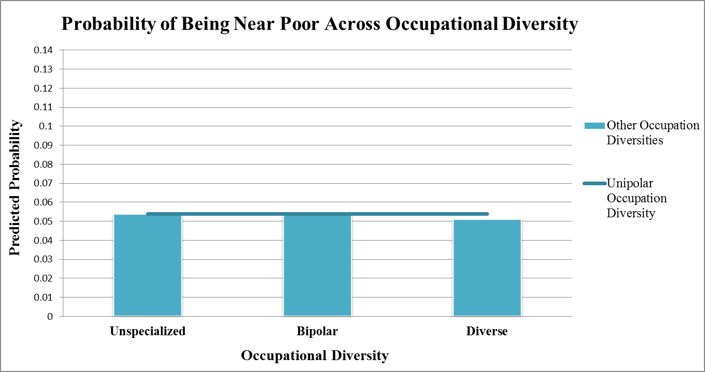
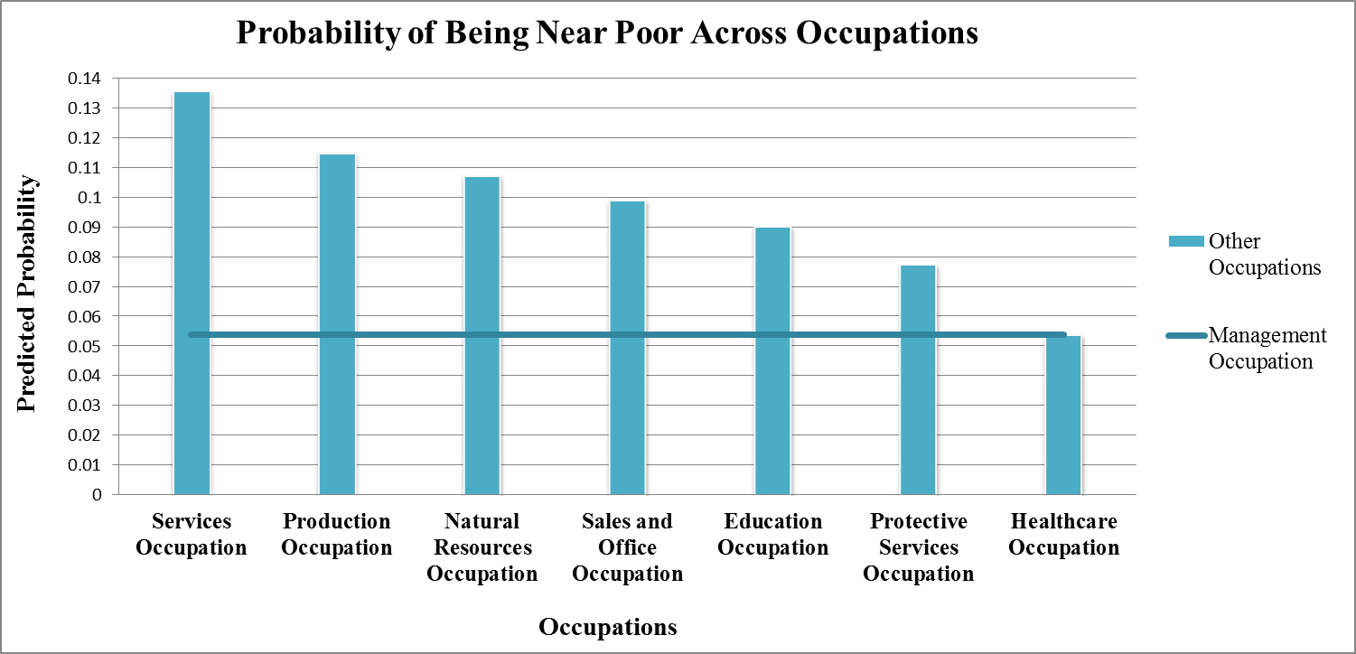
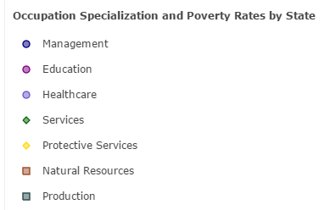
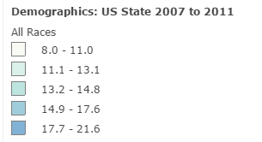
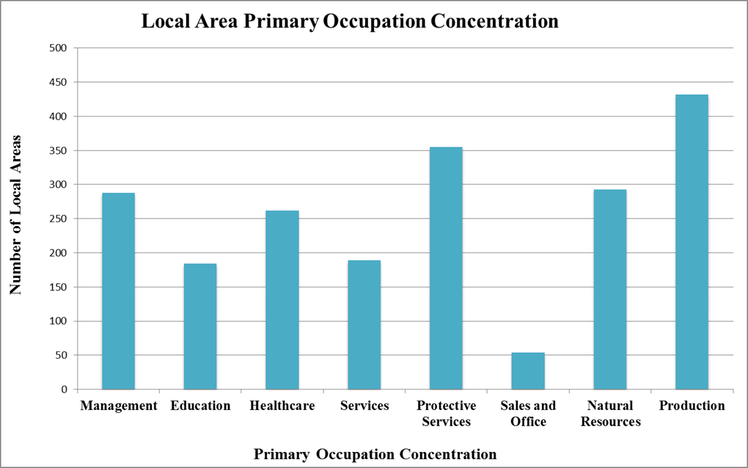
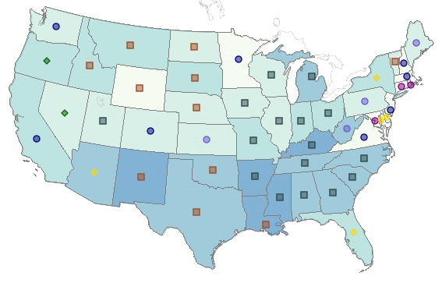
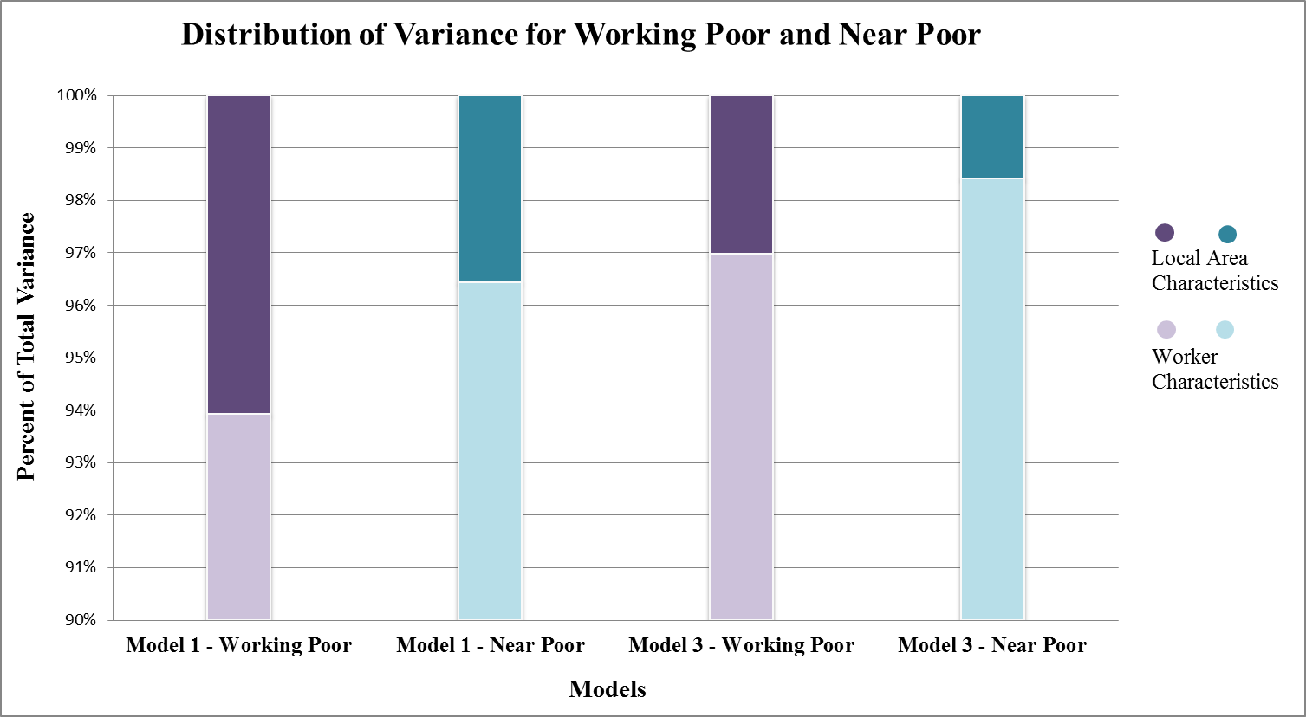
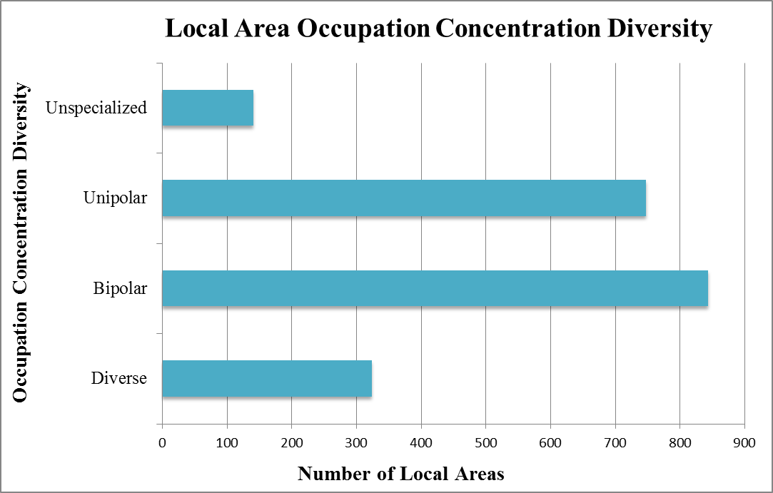
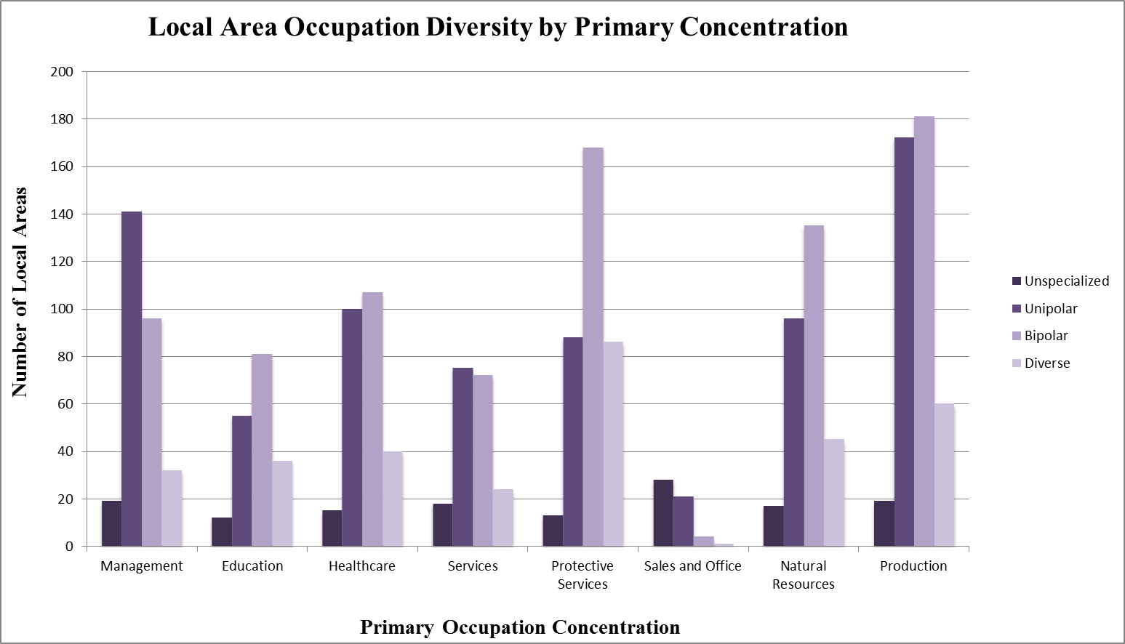
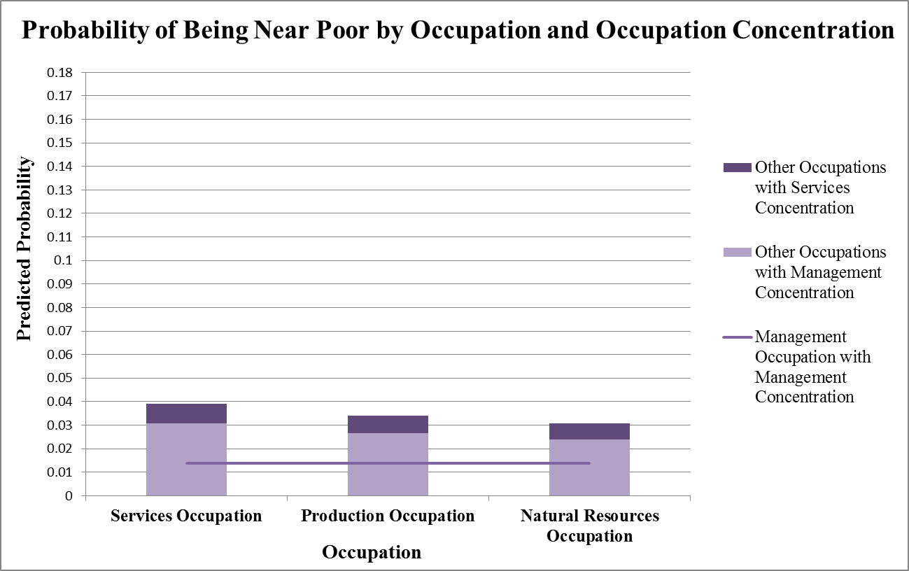
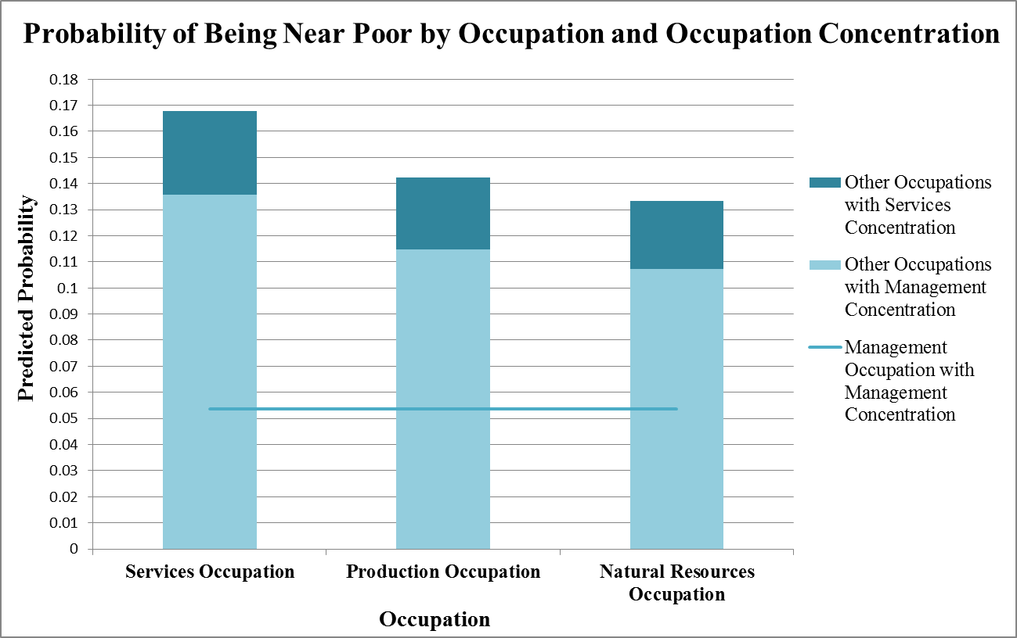
Working but Still Poor: The Role of Regional Occupational Structure in
Low-Income Work
China Layne, Ph.D.; Summit Consulting, LLC
Presented at the Association of Public Policy Analysis and Management Fall 2014 Research Conference
Albuquerque, NM
November 6 – 8, 2014
Introduction
Analysis Results
Measuring Poverty
Research in Brief
Poverty status is measured by comparing annual income to a set of poverty thresholds that vary by:
- family size,
- number of children, and
- age of the householder
(for 1 and 2 person households)
(U.S. Census Bureau, 2014).
If a family’s before-tax money income is less than the threshold, then each person in the family is considered to be poor.
Poverty thresholds are updated annually to allow for changes in the cost of living using the Consumer Price Index (CPI-U).
Poverty thresholds do not vary across regions.
We consider workers who are poor (income up to 100% of the poverty threshold) and those who are “near poor” (income from 101% to 200%).
Model Sample and Methods
A local area’s primary occupation concentration also affects a person’s likelihood of being working poor or near poor.
Model Results
Workers in certain occupations are much more likely to be working poor or near poor.
Workers are more likely to be working poor or near poor in certain areas of the country than others.
Differences in areas’ occupational composition help explain the geographic variation in working poverty.
The analysis sample includes residents of all 2,057 local areas (PUMAs) in the United States who are:
  at least 16 years of age,
  of any race and ethnicity, and
  employed.
To model a person’s likelihood of being working poor or near poor, we use two two-level, logistic, random-intercept models where:
  1,351,228 worker observations are nested within the 2,057 local areas, and
  a person’s likelihood of being working poor or near poor is allowed to vary randomly across local areas.
Management workers in local areas that specialize in Education or Services are more likely to be working poor.
Data
American Community Survey (ACS) 2011, 1-year Public Use Micro Sample (PUMS) file.
  A nationally representative survey of 3 million household addresses each year
For the occupation composition variables discussed below, the universe includes:
  Civilian residents age 16 or older,
  Employed at the time of the interview,
  In each of the 2,057 local areas and the United States total.
In this research, we group the occupations into eight categories, similar in type of work and earnings.
Management workers in local areas that specialize in Production, Services, or Natural Resources are more likely to be near poor.
The 2011 survey period covers a year early in the recovery after the Great Recession (National Bureau of Economic Research, 2014).
Local Areas: Public Use Micro Areas (PUMA) are contiguous geographies of at least 100,000 people that do not cross state boundaries.
Defining The Local Area’s Occupational Composition
A person’s occupation strongly affects their likelihood of being working poor or near poor
The effects of local area occupational composition are similar for the likelihoods of being working poor and near poor.
In this research, we conceptualize the local area’s occupational composition in two ways:
  Primary Occupation Concentration, i.e., the occupation group in which the local area is most specialized, and
  Occupation Diversity, i.e., how many different occupation groups in which the local area is specialized.
Both of these aspects of occupation composition are measured using location quotients.
Location quotients compare the share of a local area’s workforce employed in a specific occupation group to the share of the nation’s workforce in this same occupation group (Blakely and Green Leigh, 2010).
Location Quotient_{OL} = (E_{OL} / E_{TL}) / (E_{ON} / E_{TN})
  Where: E = Employed, and subscripts O = Occupation, L = Local Area, T = Total Workforce, and N = Nation.
A location quotient equal to or greater than 1.25 denotes an occupation concentration that is at least moderately strong.
A local area’s occupational diversity has a much weaker effect on a person’s likelihood of being working poor or near poor.
Conclusions
Management workers in local areas with several occupation specializations are less likely to be near poor.
Discussion
Services workers are much more likely to be working poor or near poor than management workers.
A worker’s occupation has large effects on their likelihood of being working poor or near poor.
Where a person lives also affects their likelihood of being working poor or near poor.
Specifically, a local area’s occupational composition affects a person’s likelihood of being working poor or near poor.
Workers in local areas that specialize in Services or Education are more likely to be working poor.
Workers in local areas that specialize in Services, Production, or Natural Resources are more likely to be near poor.
Workers in local areas with several occupation specializations are less likely to be near poor.
Development officials should consider the effects of local economic policies on broader employment outcomes, including low-income work.
A local area’s primary occupation concentration is the occupation group with the largest Location Quotient value.
Occupation Specialization and Poverty Rates by State, 2011
A person’s likelihood of being near poor is much higher than their likelihood of being working poor.
A person’s occupation has a stronger effect on their likelihood of being working poor or near poor than does the local area occupational composition.
In this research, we measure a local area’s occupation diversity in four categories:
  Unspecialized - No occupation concentrations
  Unipolar – One occupation concentration
  Bipolar – Two occupation concentrations
  Diverse – Three or more occupation concentrations
Overall, where a person lives matters to their likelihood of being working poor or near poor.
References
A small, but significant, share of the total variance in a person’s likelihood of being working poor or near poor is related to where the person lives.
Where a person lives is more important to their likelihood of being working poor.
Controlling for occupational composition helps explain some of the total variance related to where a person lives.
Blakely, E. J., and N. Green Leigh. 2010. Planning Local Economic Development: Theory and Practice (4th ed.). Thousand Oaks: Sage.
National Bureau of Economic Research “US Business Cycle Expansions and Contractions” accessed at: http://www.nber.org/cycles.html
U.S. Census Bureau “How the Census Bureau Measures Poverty” accessed at: http://www.census.gov/hhes/www/poverty/about/overview/measure.html
U.S. Census Bureau “Poverty Thresholds” accessed at: http://www.census.gov/hhes/www/poverty/data/threshld/index.html
Nearly half of all local areas with a specialization in management have a unipolar occupational structure.
Contact Information
Living in a local area that specializes in services rather than management adds to the likelihood that a worker in a low income occupation will be working poor or near poor.
China J. Layne:
china.layne@summitllc.us
Summit Consulting, LLC
718 7th St NW, suite 314
Washington, DC 20001
www.summitllc.us
For more information on the American Community Survey (ACS), see:
http://www.census.gov/acs/www

